Slide 1

UNIVERSITY INSTITUTE OF TECHNOLOGY BARKATULLAH UNIVERSITY BHOPAL
MAJOR PROJECT
ON
“Student Performance Prediction System Using Machine learning”
Submitted by Submitted to
Neha Ahirwar Ms. Jagriti Chand
CSE BUIT

Slide 2
Project Title
“Student Performance Prediction System Using Machine learning”

Slide 3
Outline:
Introduction and motivation
Hardware and software requirements
Aims and objectives
Literature survey
Project Description
Expected outcomes
References

Slide 4
Introduction & motivation
Performance analysis of outcome based on learning is a system which will strive for excellence at different levels and diverse dimensions in the field of student’s interests.
This system developed to analyze and predict the student’s performance only.
Education is very important issue regarding development of a country. The main objective of educational institutions is to provide high quality education to its students. One way to accomplish this is by predicting students performance and there by taking early steps to improve students performance and teaching quality.

Slide 5
Hardware and software requirements
Hardware :
Windows 7,8 or 10(32 or 64 bit)
RAM - 4GB
Software :
Python IDLE
Anaconda Navigator

Slide 6
Aims and Objective
This system aims to predict students marks using linear regression. The idea behind this analysis is to predict the marks of students by their studying hours. Through this project we can determine :
How many hours need to do the study to get 99% marks.
If I will do study x( ) hours per day so how many marks I will get.
Through these points the school / institutes can determine the performance of the student.

Slide 7
Literature Survey
Many Machine learning and data mining techniques have been used to predict the students performance such as : Artificial neural network (ANN); k-Nearest Neighbor (KNN); Support Vector Machine(SVM); Linear Regression ; logistic regression etc.
paper | features | dataset | Machine Learning Algorithms | Best Algorithm
Meier et al, 2015[4] | grades | 700 | New algorithm Proposed , KNN Linear regression, logistic regression , SVM | New algorithm proposed

Slide 8
paper | features | dataset | Machine Learning Algorithms | Best Algorithm
Guleria et al,2014[5] | Class Performance , Attendance, Assignment, Lab work , Sessional performance | 120 | DT | DT
Xu et al,2017[1] | Grades ,Backgrounds | 1169 | Linear Regression , logistic regression , RF,KNN, proposed progressive , prediction algorithm | proposed progressive , prediction algorithm.

Slide 9
paper | features | dataset | Machine Learning Algorithms | Best Algorithm
Arsad et al, 2013[6] | grades | 896 | ANN | ANN
Li et al, 2013[7] | grades | 72 | PCA | PCA
Gray et al; 2014[8] | Aptitude, personality, motivation, Learning strategies. | 914 | NB, DT, logistic regression, SVM,ANN,KNN | SVM , KNN, NB
Livieris et al, 2012[11] | grades | 279 | ANN ,DT ,NB , Rule- learning, SVM | ANN SVM

Slide 10
Project description
The essential ideas utilized in the students performance prediction model are:
Python as a programming language
Machine learning
Database
This project involves a different strategy which comprises
Data collection
Data preprocessing
Generating training and testing dataset
Model generation
Prediction & Result
Deploy ml model on local system
Flask server
Website create

Slide 11
Supervised machine learning
What is supervised machine learning ?
Supervised learning algorithms?

Slide 12
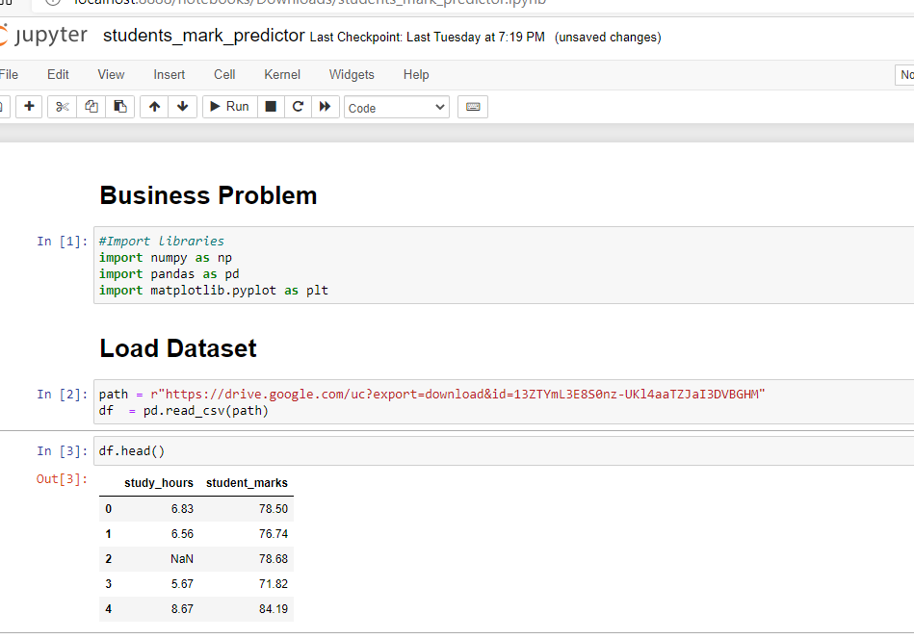
Coding

Slide 13
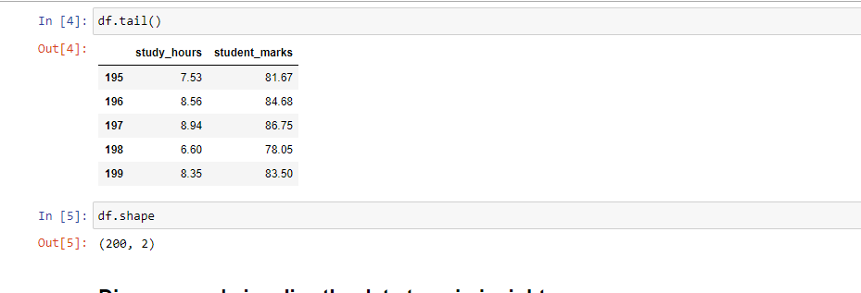

Slide 14
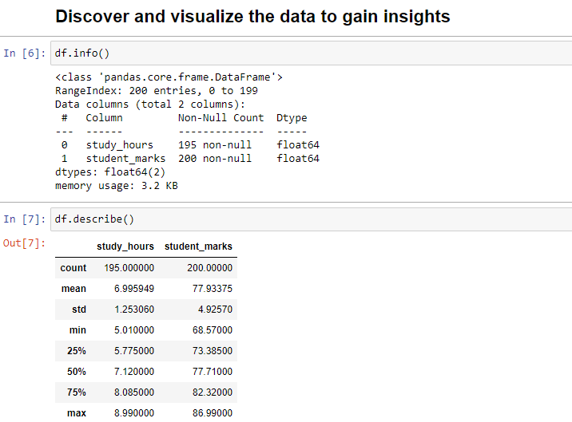

Slide 15
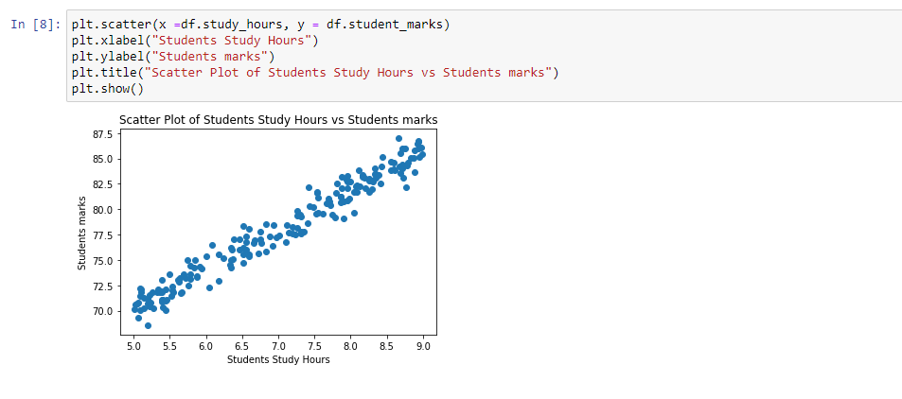

Slide 16
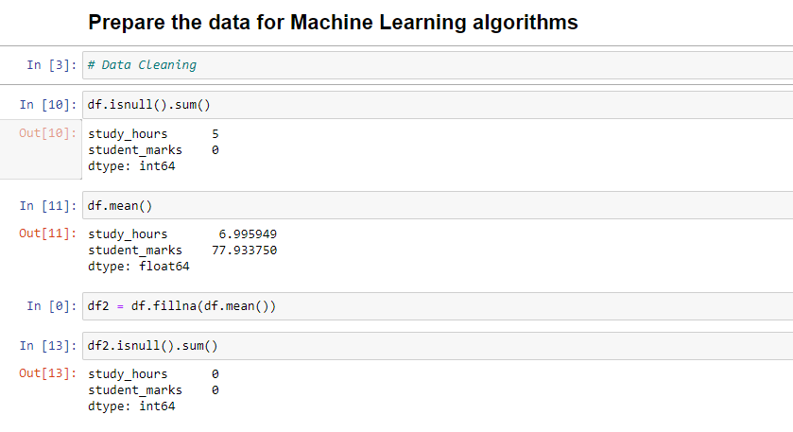

Slide 17
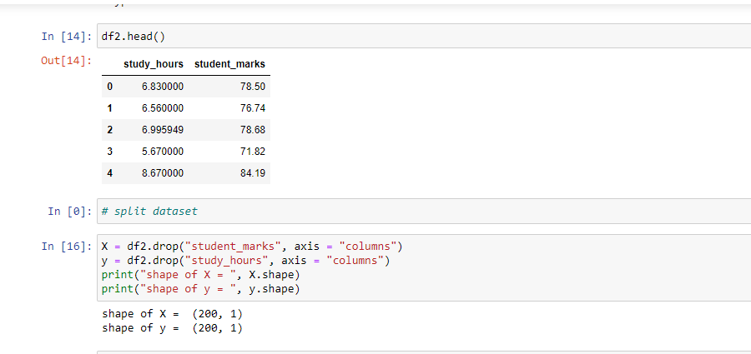

Slide 18
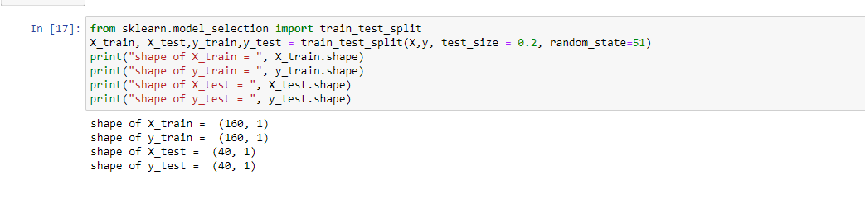

Slide 19
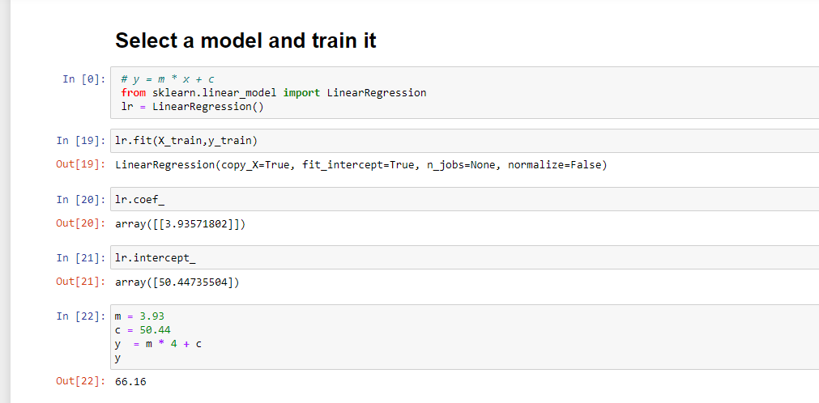

Slide 20
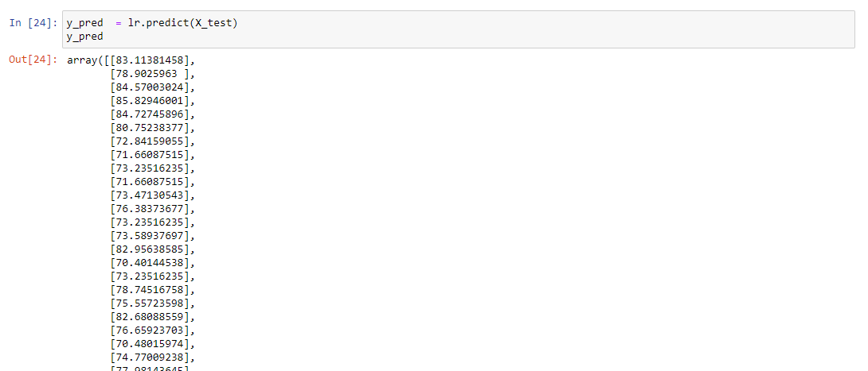

Slide 21
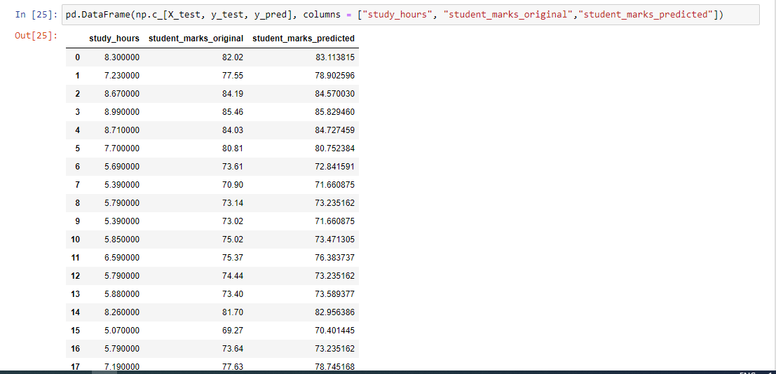

Slide 22
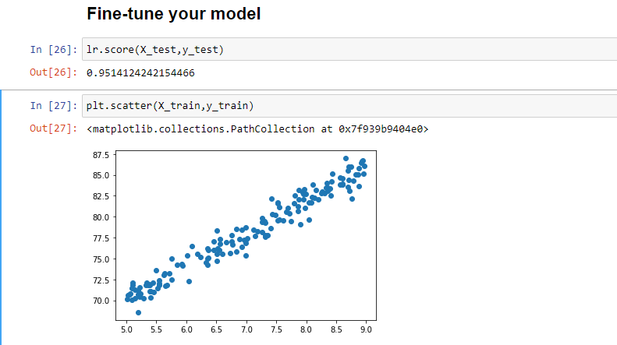

Slide 23
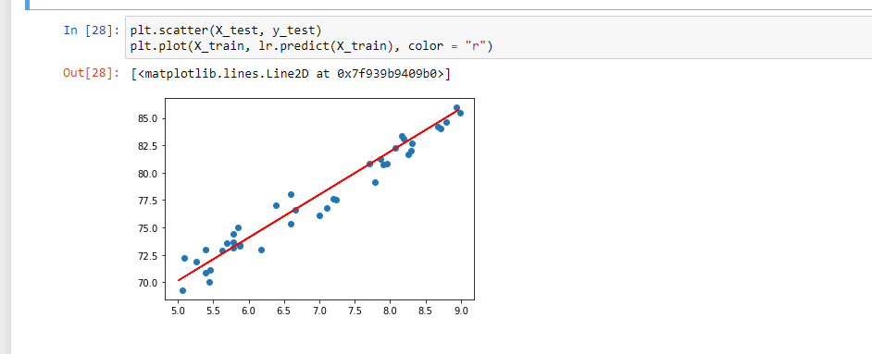

Slide 24
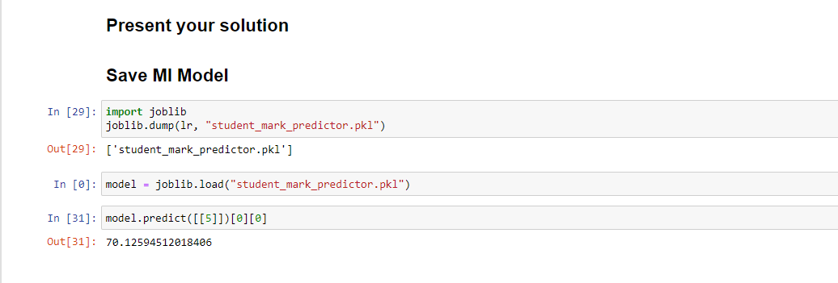

Slide 25
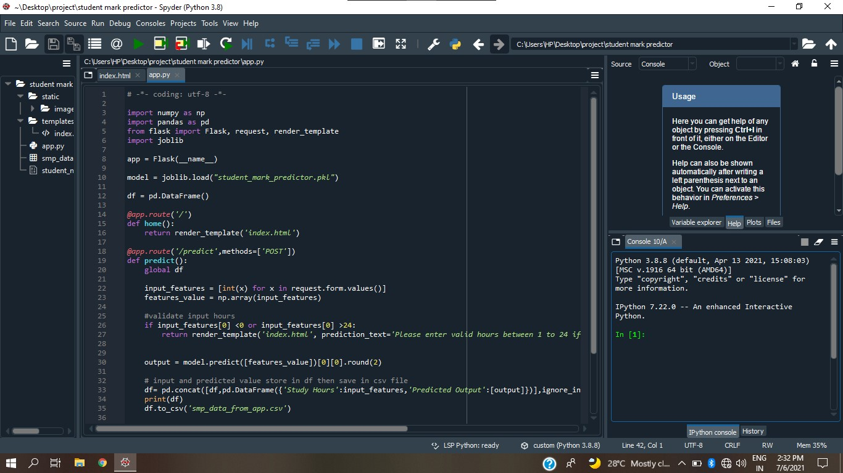
DEPLOY ML MODEL ON LOCAL MACHINE

Slide 26
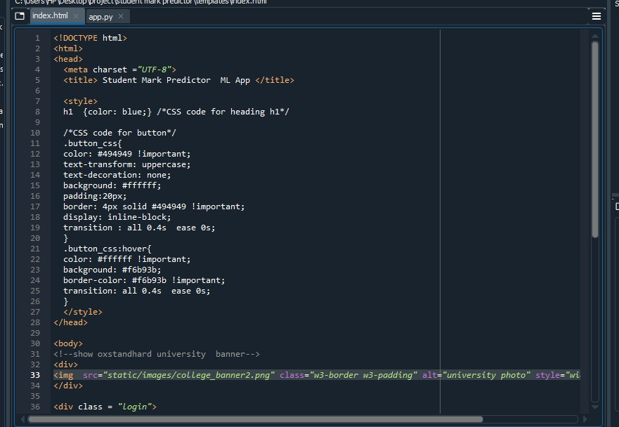

Slide 27
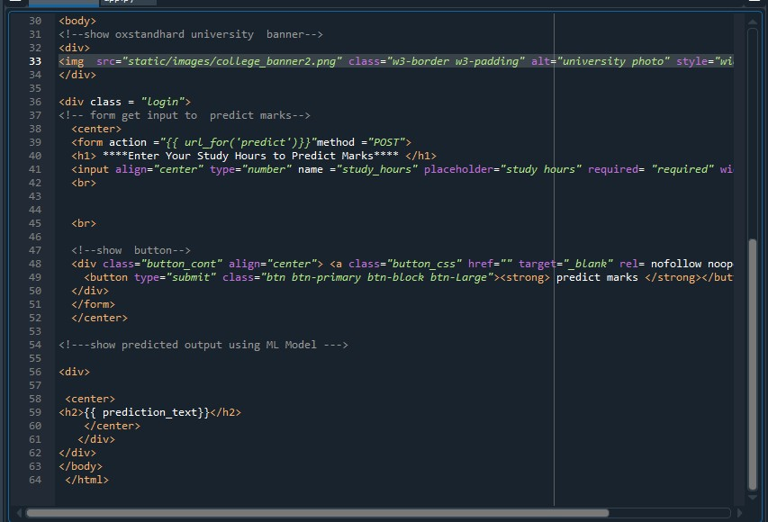

Slide 28


Slide 29
Challenges in supervised machine learning
Data preparation and pre-processing is always a challenge.
Accuracy suffers when impossible, unlikely, and incomplete values have been inputted as training data.

Slide 30
Expected outcomes
This system aims to predict students marks using linear regression. Through this project we can solve the business problem like
How many hours need to do the study to get 99% marks?
How many hours need to do the study to pass the exam?
If I will do study X(4) hours per day so how many marks I will get.

Slide 31
REFERENCE
www.jetir.org(ISSN-2349-5162)
https://github.com/furkhan26/predicting
www.researchgate.net
https://youtu.be/U_oJqcyc0eI

Slide 32
Thank you

